Slide 1

SOCIAL ENGINEERING ATTACKS IN THE DIGITAL AGE
SHIMNA SHERIN P T MES24MCA-2053

Slide 2
TABLE OF CONTENTS
Introduction
Background and Need
Objectives
Overview of Social Engineering Attacks
Types of Attacks
Real-Life Examples
Impact
Prevention
Limitations
Future Scope
Conclusion
References

Slide 3
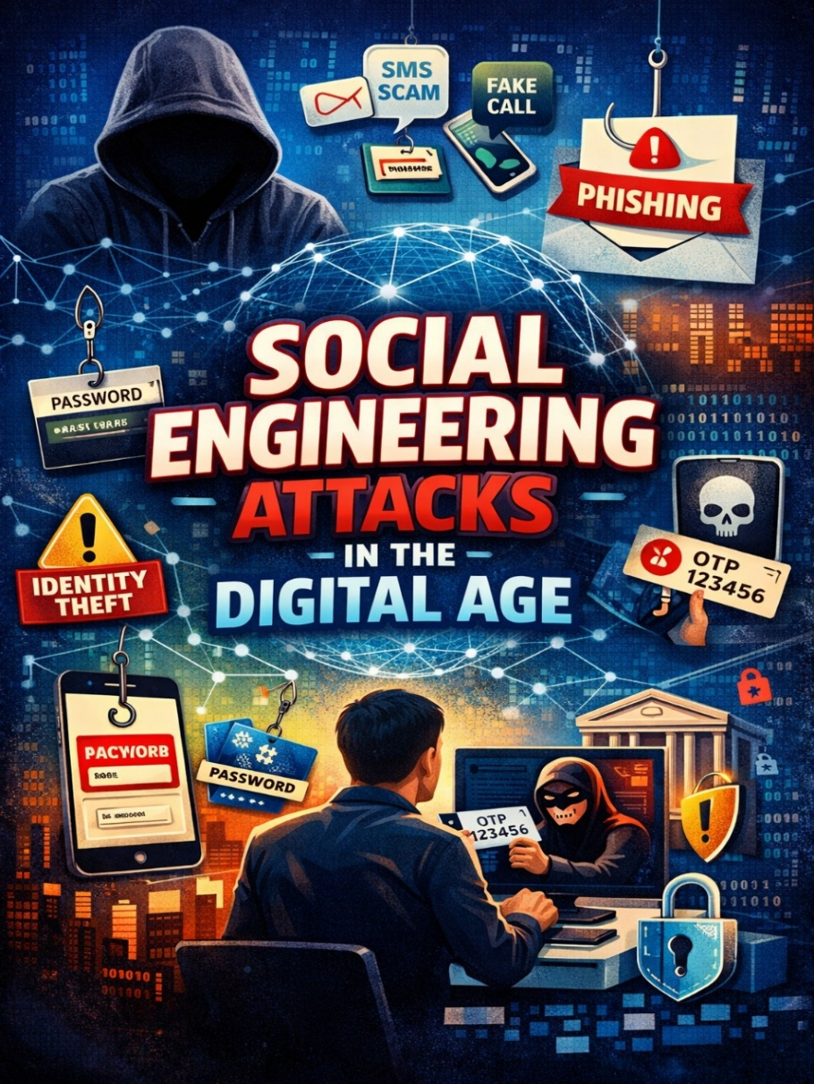
Introduction
Social engineering attacks are one of the most common and dangerous cyber threats today.
Instead of hacking computers, attackers manipulate human psychology to steal information.
They trick people into giving passwords, OTPs, bank details, and personal information.
Understanding social engineering attacks helps protect digital assets and improve cybersecurity awareness.
1

Slide 4
Background and Need
People use the internet, emails, and social media more in the digital age.
Social engineering attacks target human trust instead of system weaknesses.
Attackers trick users into sharing passwords, OTPs, and personal details.
These attacks are increasing because they look real and easy to execute.
2

Slide 5
Objectives
To understand what social engineering attacks are.
To learn the different types of social engineering attacks.
To know how these attacks affect individuals and organizations.
To understand simple ways to prevent social engineering attacks.
3

Slide 6
Overview of The Social Engineering Attacks
Social engineering attacks use psychological tricks to fool people.
Attackers try to gain trust to steal information like passwords or OTPs.
These attacks mainly target human behavior, not computer systems.
Social engineering attacks happen through emails, calls, messages, and social media.
4

Slide 7
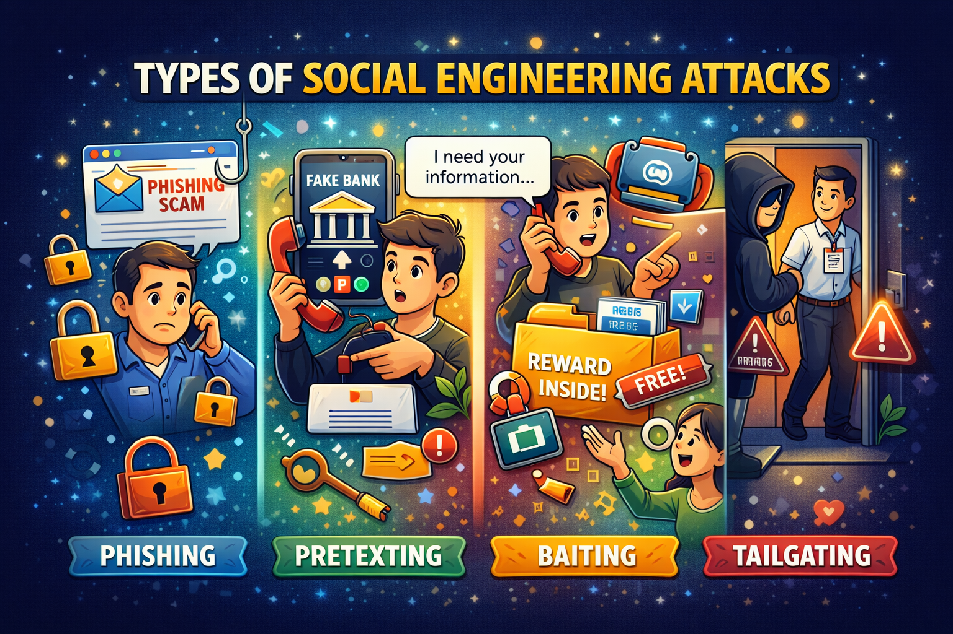
Types of Attacks

Slide 8
Types of Attacks
Phishing
Fake emails or messages are sent to steal personal information.
Example: A message says “Your bank account is blocked” and the link leads to a fake website
2. Pretexting
Attackers create a fake story to gain trust.
Example: Someone pretends to be an IT staff member asking for login details.

Slide 9
Types of Attacks
3. Baiting
Baiting is an attack where hackers lure users with attractive offers.
Example: A message saying ”free mobile recharge” asks you to click a link
When you click it , malware gets installed or your data is stolen
4. Tailgating
Tailgating is when an unauthorized person enters a secure place by following an authorized person
Example: An employee enters an office using an ID card
A stranger follows saying “I forgot my card”
The employee allows entry
This is called a tailgating attacks

Slide 10
Real-Life Examples
Fake bank messages asking to click links
Fraud calls asking for OTP or PIN
Fake job offers demanding money or details
Social media links used to hack accounts
6

Slide 11
Impact
Financial Loss Example: Fake bank call → OTP share → money lost
Identity Theft Example: Fake website → Aadhaar & password entered
Data Breach Example: Phishing email → office login hacked
Loss of Trust & Reputation Example: Company data leaked → people stop trusting

Slide 12
Prevention
Users should be aware of social engineering attacks and common online scams.
Always verify unknown emails, messages, and phone calls before responding.
Using strong passwords and multi-factor authentication can improve security.
Never share passwords, OTPs, or personal details with anyone.
8

Slide 13
Limitations
Human behavior is unpredictable
Lack of user awareness
Attack methods keep evolving
Technology alone is not sufficient

Slide 14
Future scope
Increased cybersecurity awareness programs
Advanced detection techniques using AI
Stronger authentication methods
Better user education and training
10

Slide 15
Conclusion
Social engineering attacks exploit human trust rather than technology
These attacks are increasing in the digital age
User awareness is the strongest defense against such attacks
Safe digital practices help protect individuals and society

Slide 16
References
[1] Mitnick, K., & Simon, W. L. (2002). The Art of Deception: Controlling the Human Element of Security. Wiley Publishing.
[2] OWASP Foundation. (2023). Social Engineering Attacks Overview. OWASP Official Documentation. https://owasp.org/www-community/social-engineering
[3] Cisco Systems. (2024). Cybersecurity Threat Trends: Social Engineering and Phishing. Cisco Security Reports. https://www.cisco.com/c/en/us/products/security/security-reports.html
[4] Hadnagy, C. (2018). Social Engineering: The Science of Human Hacking. Wiley.
[5] Trend Micro Research. (2024). Understanding Phishing, Vishing, and Smishing Attacks. https://www.trendmicro.com/vinfo/us/security/definition/social-engineering
19

Slide 17


